Slide 1
Collaborative Reasoning Skills 1

Slide 2
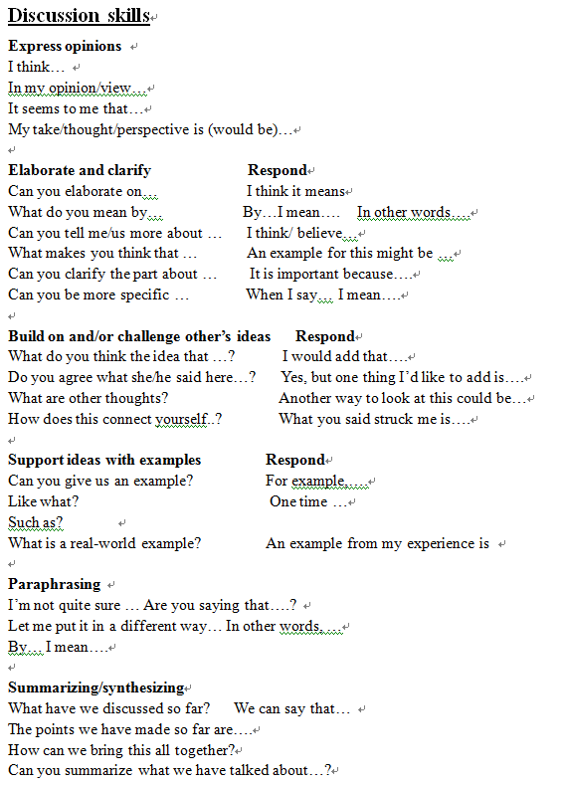
Useful language

Slide 3
An Example
Yu: I think Oliver should learn to dance. Just now, Han said that, if Oliver does not keep practicing basketball and all kinds of ball games, his skills will be worse. Han, I wanted to ask you, why do poor ball skills matter? If he is not good at ball games, but he dances well he can be a star later and will be adored.
Zhou: Yu, I agree with you. If Oliver learns to dance, he will be happy dancing on the stage, but he will be sad at school.
Cheng: Qi, what do you think about Zhou’s opinions?
Qi: Zhou, I agree with you. I also had a similar experience, but I was not being teased. I learned painting before. When I started the painting class, I could not pain well, and it was not possible to win the first prize. I must learn the basics, but the more you practice, the better you are. Finally, I was able to paint better than others in the area.
Han: Qi, I do not agree with you because you said that painting skills can be better and better, if he learns to play ball, his skills can be better and better, too.
Teacher: Take it easy. You are in opposite positions. Your high enthusiasm is great, but one person at a time, take turns and do not interrupt each other, ok?

Slide 4
An Example
Cheng: Han, I do not agree with you. Although you said that you may learn well, (but) now he is now being teased by others. If he continues to play ball, he will not be popular. It is better for him to make good friends with those in the dance class, so that he can not only enjoy happiness from his friends, but also the happiness of his own (dance).
Liu: Isn’t it ok to play with girls?
Han: Liu, I do not agree with you, because you said that “isn’t ok to play with girls? “ From this picture it shows that a lot of boys are laughing at him. If a boy relies on the help of girls, he may feel shamed. If he plays with girls, other people will laugh at him even more.
Cheng: But I have heard a saying, “follow your own course, and let people talk.” At first I did not understand this saying. Later, I figured it out, that is, people should have their own goals. No matter what obstacles you may face and how other people may treat you, you must be persistent in your faith and you will then be successful.

